Slide 1
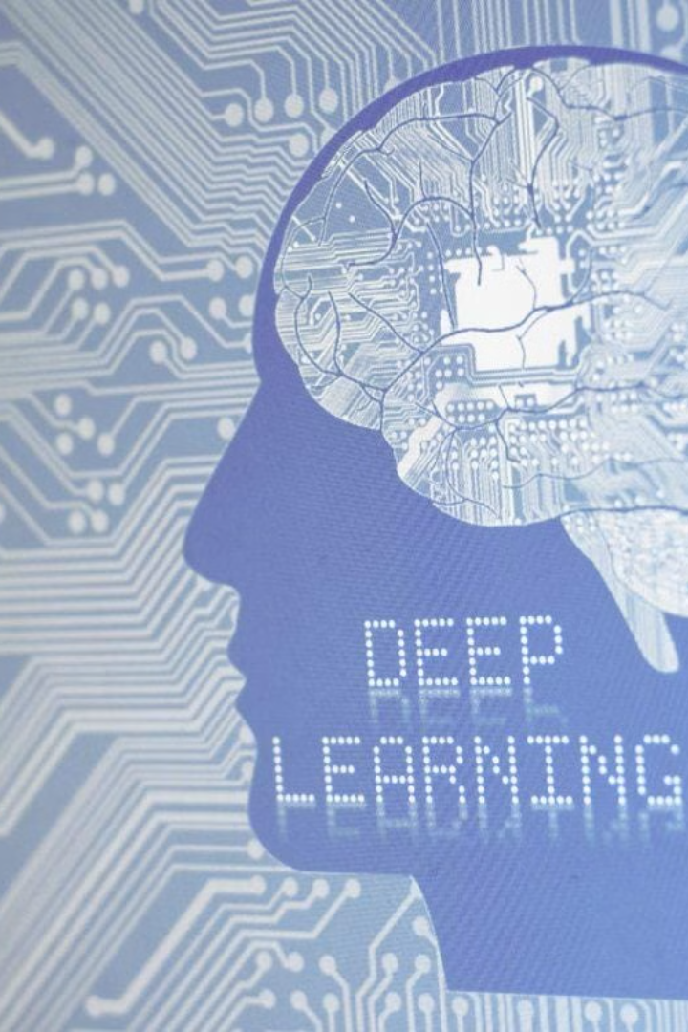

POWERPOINT PRESENTATION FOR CA1
NAME - SARTAJ AZIZ
ROLL- 13000120003
TOPIC - DEEP LEARNING
SUB- PEC-CS701E

Slide 2

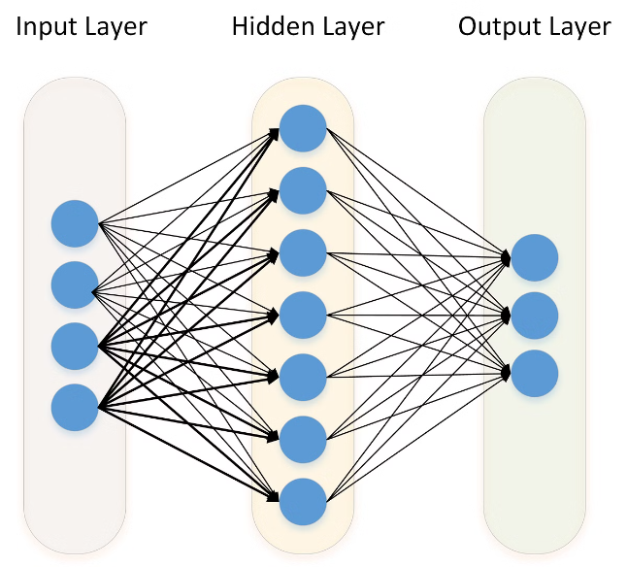
Introduction to Deep Learning
Deep learning is a subfield of machine learning that utilizes artificial neural networks (ANNs) with multiple layers to learn from data. Deep learning algorithms can be used to solve complex problems, such as image recognition, natural language processing, and predictive modeling.

Slide 3

Fundamentals of Neural Networks
Neural networks are inspired by the structure and function of the human brain. They are composed of interconnected nodes called neurons, organized in layers. Each neuron receives inputs, applies a transformation, and produces an output. These outputs are then passed to subsequent layers, allowing the network to learn complex patterns.
1
Perceptrons
2
Activation Functions
Perceptrons are the simplest type of neural network, capable of classifying binary data.
Activation functions introduce non-linearity into the neural network, allowing it to learn more complex patterns.
3
Backpropagation
4
Optimization Algorithms
Backpropagation is an algorithm used to train neural networks by adjusting the weights of the connections between neurons.
Optimization algorithms, such as gradient descent, are used to find the optimal set of weights that minimizes the error during training.

Slide 4
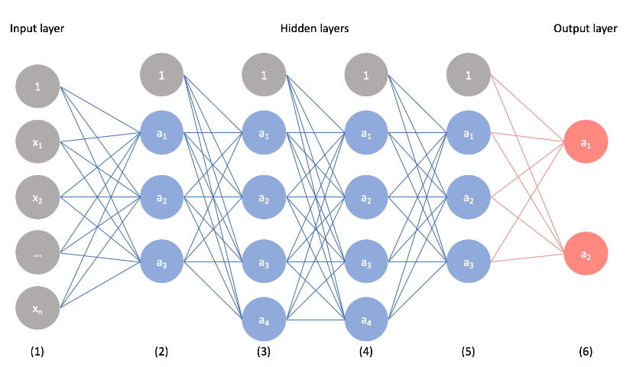
Convolutional Neural Networks
Convolutional neural networks (CNNs) are specifically designed for image processing. They utilize convolutional layers that apply filters to extract features from the input image.
Convolutional Layers
Applications
Convolutional layers perform feature extraction by sliding a filter across the input image, computing the dot product at each location.
CNNs have achieved state-of-the-art results in various applications, including image classification, object detection, and image segmentation.
Feature Maps
Pooling Layers
Fully Connected Layers

Slide 5

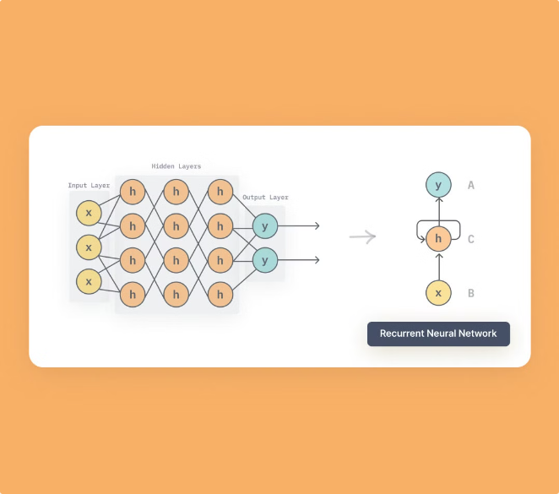



Recurrent Neural Networks
Recurrent neural networks (RNNs) are designed to handle sequential data, such as text and speech. They incorporate feedback loops that allow information from previous time steps to influence the processing of current data.
Long Short-Term Memory (LSTM)
LSTMs are a type of RNN that address the vanishing gradient problem by introducing memory cells to store information over long time periods.
Gated Recurrent Unit (GRU)
GRUs are another type of RNN that simplifies the LSTM structure by using fewer gates, making them more efficient.
Applications
RNNs are widely used in natural language processing tasks, such as machine translation, text summarization, and sentiment analysis.

Slide 6

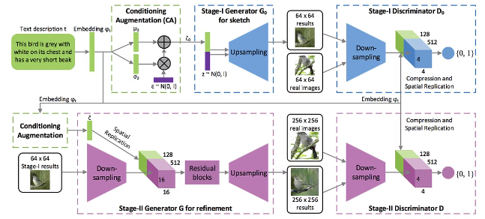
Generative Adversarial Networks
Generative adversarial networks (GANs) consist of two neural networks, a generator and a discriminator, that compete against each other during training. The generator learns to generate realistic data, while the discriminator learns to distinguish between real and generated data.
Generator
Discriminator
Generates synthetic data
Distinguishes between real and generated data
Aims to fool the discriminator
Aims to correctly classify real and generated data
Improved with adversarial training
Improved with adversarial training

Slide 7

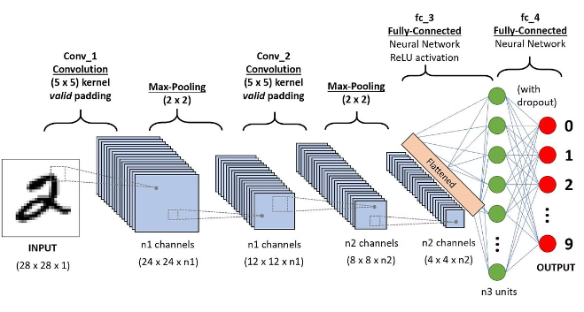
Deep Learning Architectures
Deep learning architectures are complex structures that combine different types of neural networks and layers to solve specific problems. They are designed to extract features, process information, and generate outputs effectively.
Autoencoders
Transformer Networks
Autoencoders are unsupervised learning models that learn to represent input data in a compressed form.
Transformer networks have revolutionized natural language processing by introducing a self-attention mechanism that allows them to capture long-range dependencies in text.
Deep Belief Networks (DBNs)
DBNs are generative models that stack multiple layers of restricted Boltzmann machines to learn hierarchical representations of data.

Slide 8





Applications of Deep Learning
Deep learning has revolutionized various industries, enabling breakthroughs in areas such as computer vision, natural language processing, and robotics.
Image Recognition
Natural Language Processing
Robotics
Predictive Modeling
Deep learning models can accurately identify objects and scenes in images, powering applications like facial recognition, self-driving cars, and medical imaging.
Deep learning enables robots to learn from experience, adapt to new environments, and perform complex tasks, such as object manipulation and navigation.
Deep learning models can predict future events based on historical data, enabling applications in finance, healthcare, and weather forecasting.
Deep learning models can understand and generate human language, leading to advancements in machine translation, chatbot development, and text summarization.

Slide 9

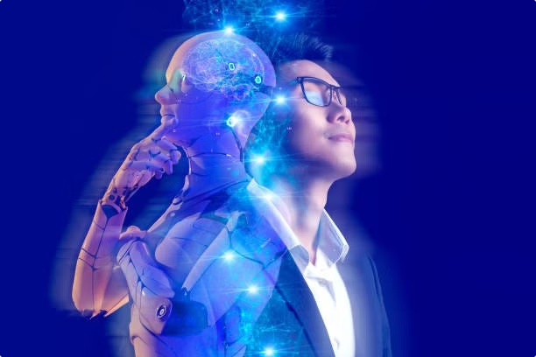
Future Trends in Deep Learning
The field of deep learning is constantly evolving, with new research and advancements pushing the boundaries of what is possible. The future holds exciting possibilities for deep learning, including further advancements in natural language processing, computer vision, and artificial general intelligence.
1
Explainable AI
Focus on developing deep learning models that are more transparent and interpretable, allowing users to understand how decisions are made.
2
Federated Learning
Training deep learning models on decentralized data, preserving privacy and enabling collaboration without sharing raw data.
3
Quantum Machine Learning
Leveraging the power of quantum computing to accelerate deep learning algorithms and solve more complex problems.

